Slide 1
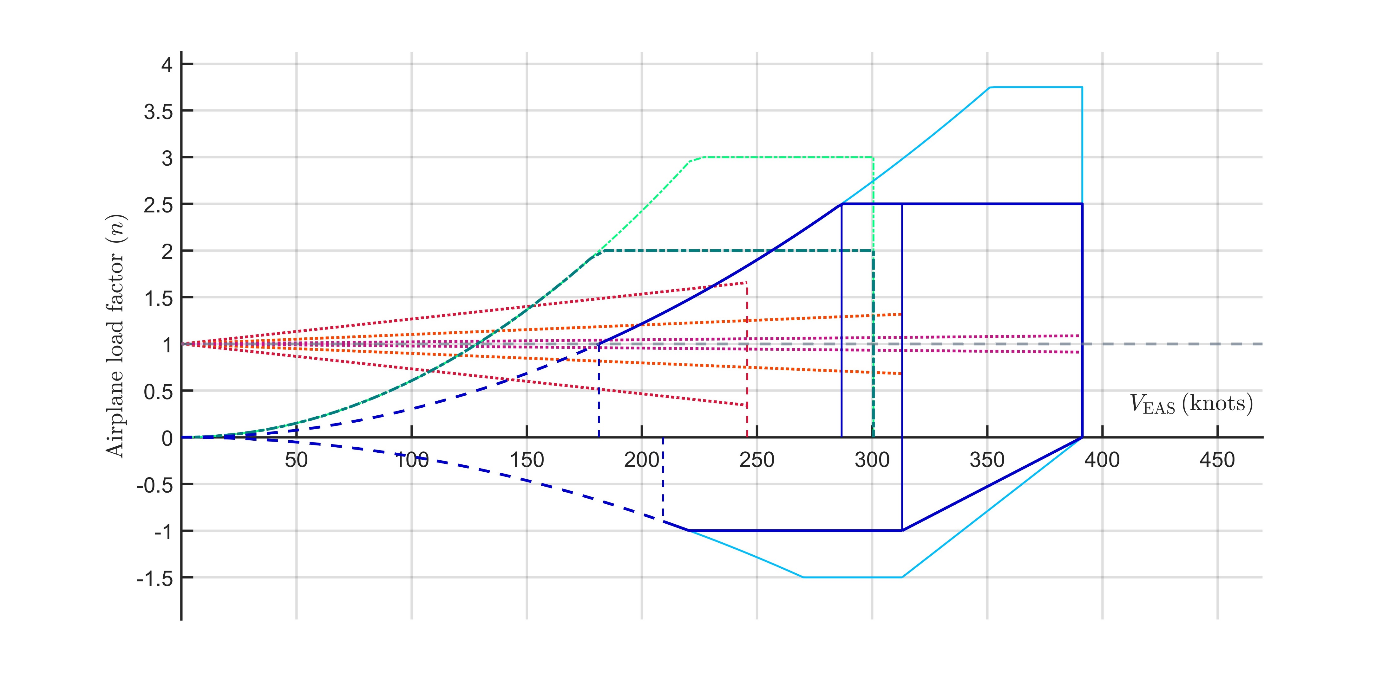






















$$Flaps up$$
$$Structural failure area$$
$$Structural$$
$$damage area$$
$$Flaps down$$
$$V_{A}$$
$$V_{C}$$
$$V_{D}$$
$$Structural$$
$$damage area$$
$$V_{F}$$
$$U=+58fps$$
$$V_{B}$$
$$Structural$$
$$failure area$$
$$U=+43fps$$
$$U=+22fps$$
$$U=−22fps$$
$$U=−43fps$$
$$U=−58fps$$
$$V_{S1}$$
$$V_{S1,min}$$
$$Structural$$
$$damage area$$
$$W=429900 kg$$
$$h=28000 ft$$
$$Structural failure area$$

